Slide 1
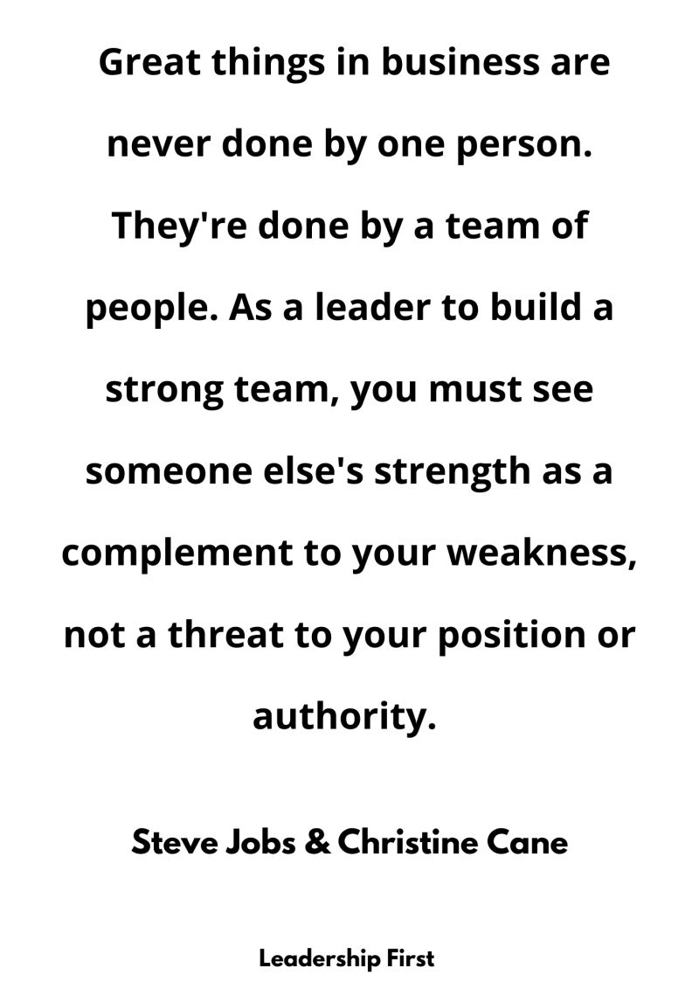
CSE 170 Technical Teamwork
What comes next? OTTFFSSE?
W. Clements

Slide 2
Overview
Review
Blooket
Reading
“7 Ways to Build Influence in the Workplace Download 7 Ways to Build Influence in the Workplace " by Jason Demers
"Everyone Has Influence Download Everyone Has Influence " by Lindsay Curtis
Study the Multidimensional Influence Model (MIM) Download the Multidimensional Influence Model (MIM) diagram.
Multidimensional Influence Model (MIM)

Slide 3
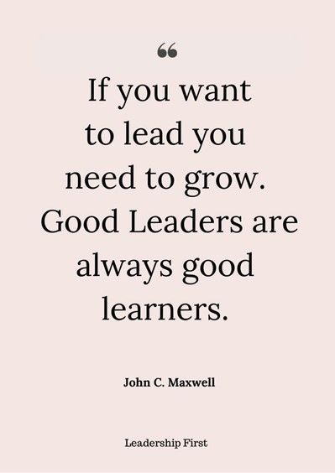
Review
What blessing did Pres. Eyring leave with his listeners?
How does this blessing apply to you?
Why is teamwork important?

Slide 4
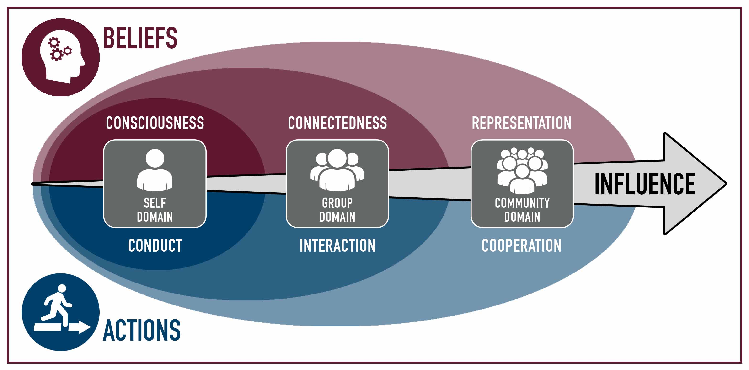
Multidimensional Influence Model (MIM)

Slide 5
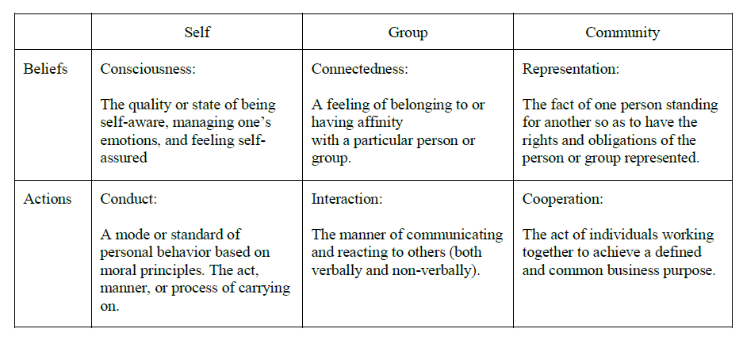
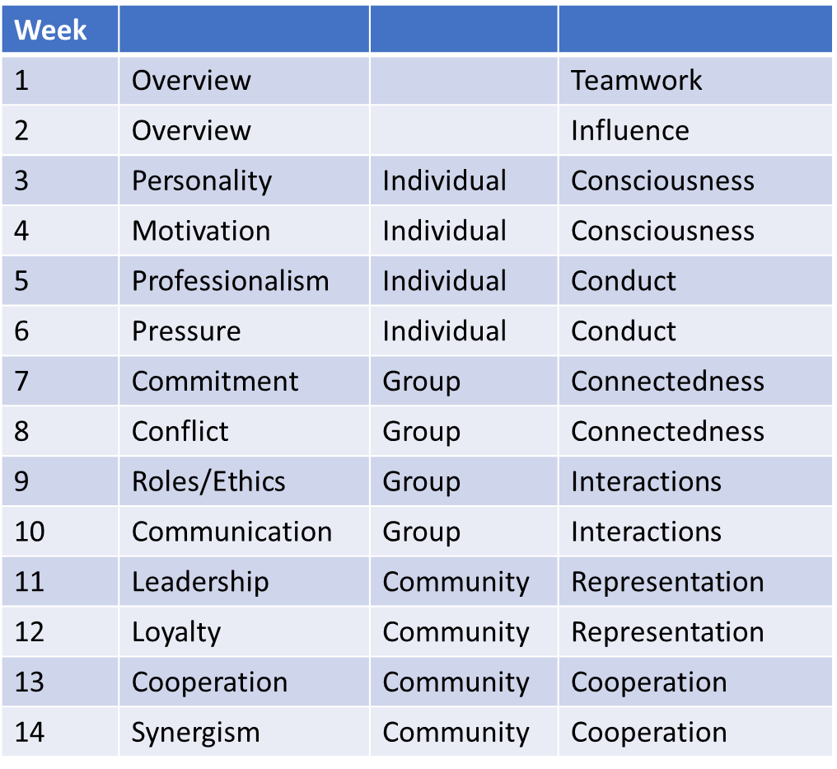
Multidimensional Influence Model (MIM)

Slide 6
Quotes from Teamwork
“A study of any field or discipline, when taken seriously, can yield positive benefits to anyone's employment or life skills. Learning something new, assuming that it is correct or good information, will always positively impact a person.” Sigler
Ms. Elisabeth Kasson's states that all the soft skills depend on how well we communicate with others, and having the teamwork soft skill will help us to full fill the clients and companies needs; she also states on her article that having the teamwork skill will help us to communicate effectively in order to learn how to solve problems as a team. – Varela
If you can not trust the others on your team to do their jobs, your own job can not be accomplished safely nor effectively. – Whitter
I do believe that teamwork is one of the most important skills to have in our day and age. – Mckinney
Teamwork is one of the best things. Not only does is show great results but some of my best times that I look back on came from being on some sort of team and working together to reach something greater and being able to celebrate that accomplishment together.
Imagine writing a piece of software like Photoshop by yourself. - McConkie

Slide 7
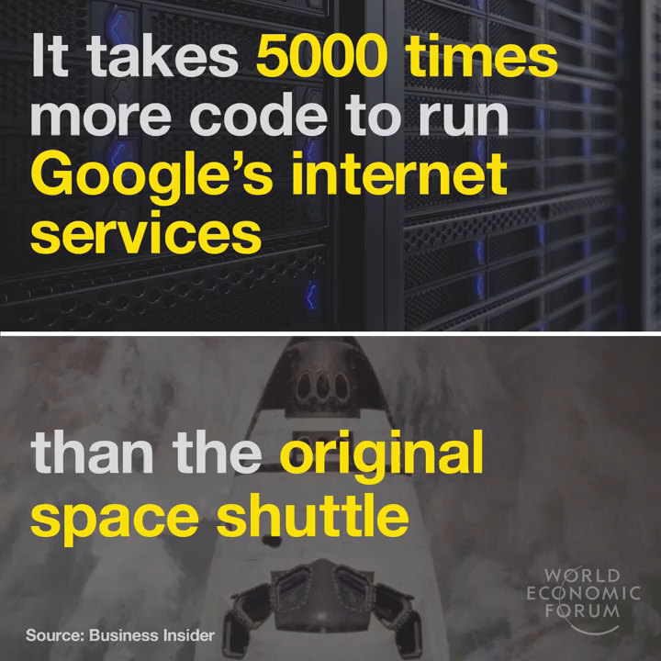
How many lines of code can you program in your lifetime?
Average programmer code 3-10 lines per hour
There are 2000 working hours in a year (52 weeks -2 vacation * 40 hr/wk)
From age 25-65 is 40 years
How many lifetimes does it take to write these programs?
And with a team?
Will the market wait for a lifetime?

Slide 8
Teamwork change of thought…
A team can provide better efficiency in the workplace.
In my past, teamwork has always been a negative thing. For me it meant that I would be doing the work of four people while everybody else in the team got an 'A' for doing nothing. I now am excited to work with a team who each person wants to put in their work.
The way my mindset has changed on the concept of teamwork is that it's become less of a nuisance and more of a way to learn how to better communicate and learn more from others.
Before this class teamwork, to me, was just a word used to describe when a bunch of people got together and worked. Now I see it as a tool. A tool that when utilized properly can turn a mountain of work into a small hill of effort. Teamwork is about cooperating with each other, not working on your piece and ignoring everyone else.
Often when working in a team we tend to focus on the easier issues at hand, probably because these issues are things we are comfortable speaking on.
I definitely realize and see that there are a lot of aspects involved in teamwork. There are so many determinants that go into how a team is affected. It made me realize especially how my attitude, behavior, and mindset is when I am working in a team myself.

Slide 9

Review of Demer’s 7 Ways to Build Influence in the Workplace
Influence is power
Influence has countless advantages, but gaining that influence, like learning a skill, takes time and effort.
7 Ways to Build Influence in the Workplace
1. Build Trust With Your Co-Workers.
2. Cultivate Reliability Through Consistency
3. Be Assertive, Not Aggressive.
4. Be Flexible.
5. Be Personal.
6. Focus on Actions Rather Than Argument.
7. Listen to Others.

Slide 10
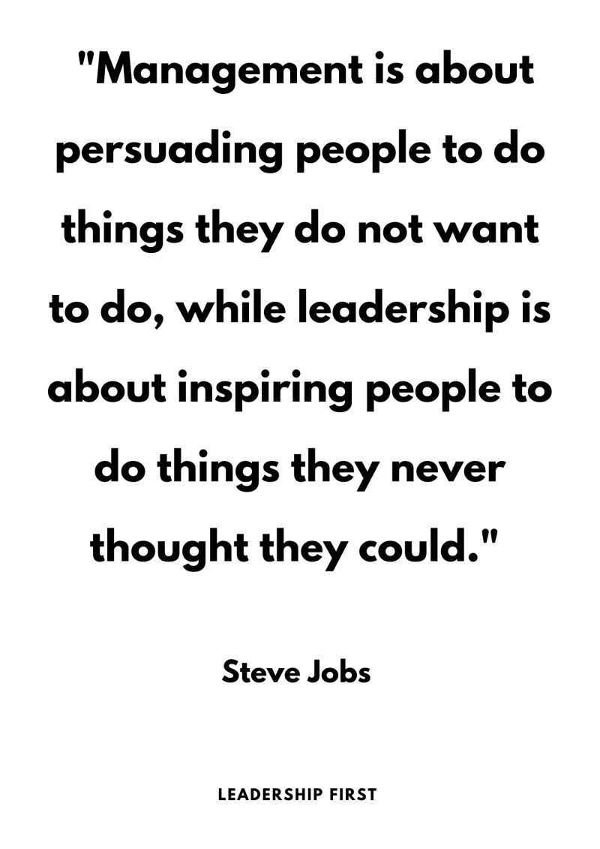
Influencers…
It is what you do and not what you say…
It is your passion that people will follow, not your product…
It is your example of your testimony that shows people…
…

Slide 11
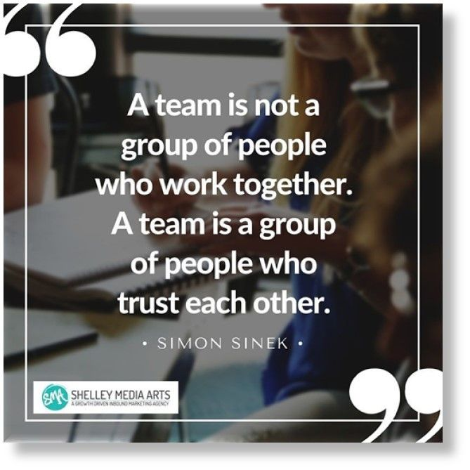
Review of Curtis’s Everyone Has Influence
Magnetism, consciously, intentionally or not
“If that’s the way he or she feels about it, that’s good enough for me.”
Pipe wrench – tool
Have you ever justified your behavior?
What tools have you seen that have been used or not used?

Slide 12
The Meaning of Influence
What is a social media influencer? Who are they? What do they do?
Is this what Mr. Demer means by influence? Why or why not?
Is this what Pres. Eyring means by influence? Why or why not?
How does Sister Curtis define influence?
How is her viewpoint different from Mr. Demer’s?
Is this what Pres. Eyring means by influence? Why or why not?
Agree or Disagree: “You are being sold something, or you are selling something.”
Agree or Disagree: “Excuses are well-planned lies”

Slide 13
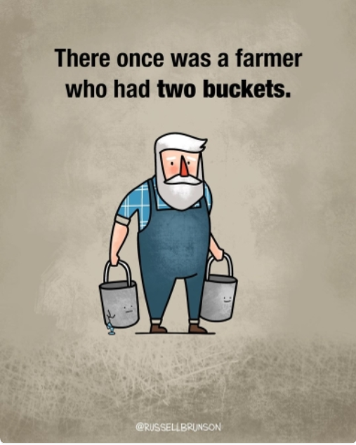
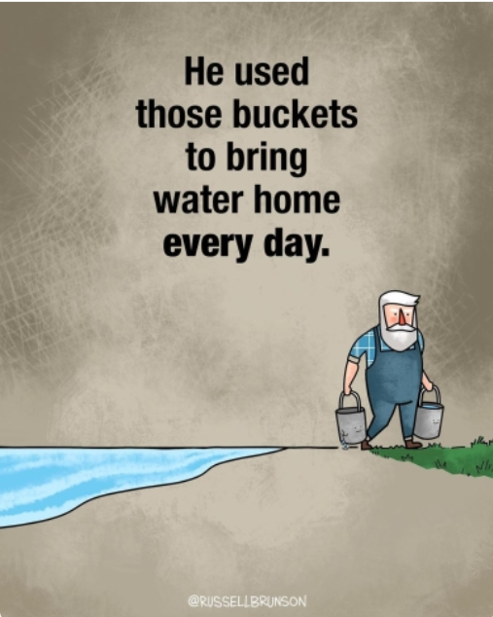
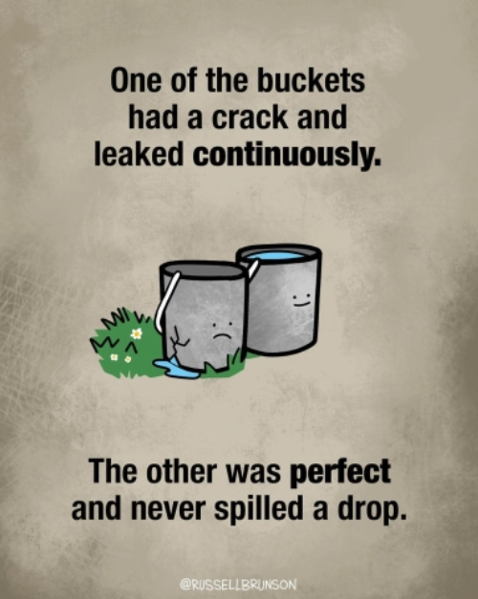
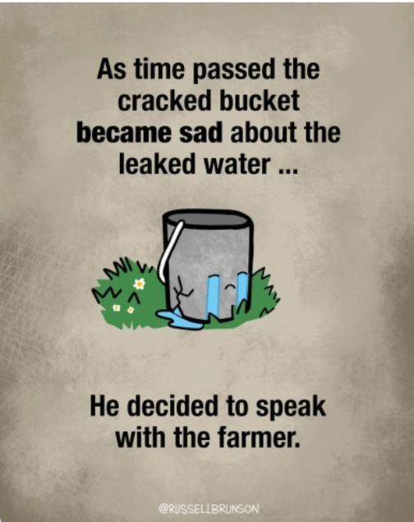

Slide 14
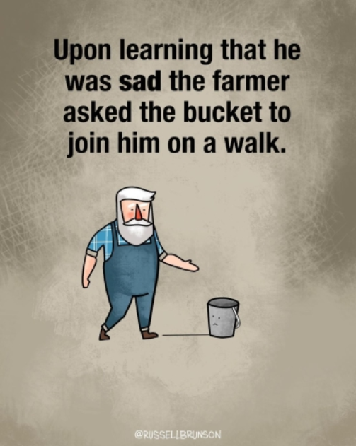
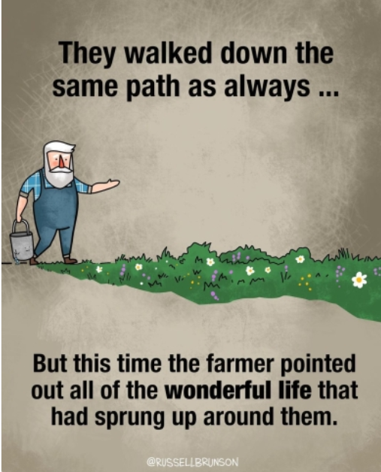

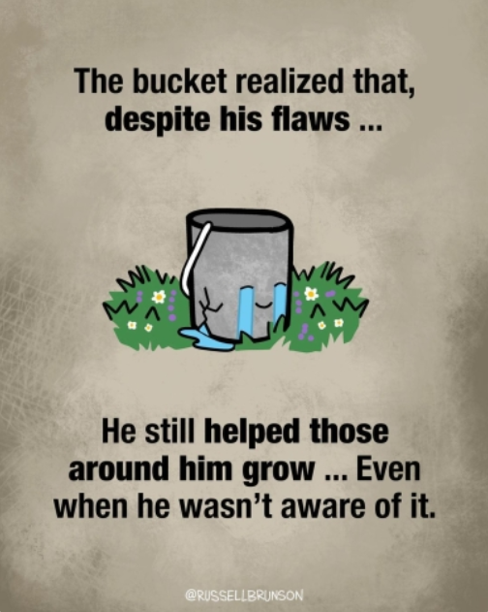

Slide 15
Next Class period
Bring your laptops

Slide 17
Class Time
Think about the difference between these viewpoints
Write a new, gospel-oriented definition for the word influence
Review, vote and post the best definition of influence

Slide 18
Influence
Influence on Self
Consciousness
Conduct
Influence on Group
Connectedness
Interaction
Influence on Community
Representation
Cooperation
Select one characteristic that “Needs work” and reflect on ways you might improve.

Slide 19
Compare and Contrast
Consistent with our gospel-oriented view of mortal existence
Relationship between competencies, domains and influence
Driving question, teamwork through the MIM lens

Slide 20
New way of submitting homework
PC
LMS: Canvas: iLearn
Folder
Reflection.doc/pdf
Upload
GitHub
Reference
GitPages
Link
But Y? Teamwork collaboration tool of the industry

Slide 21

GitHub
Create a GitHub Account
Signing up for a new GitHub account
Create your account
Create Repository
Configure GitPages

Slide 22
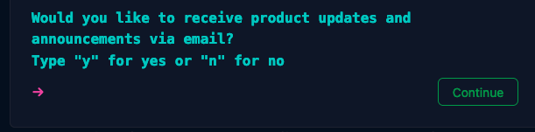
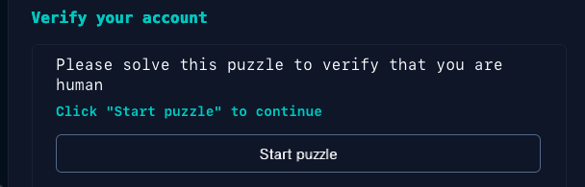
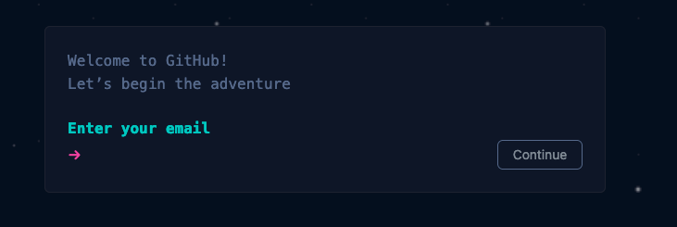
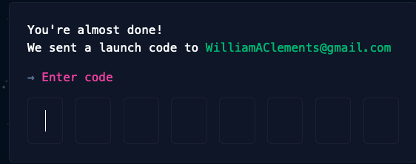
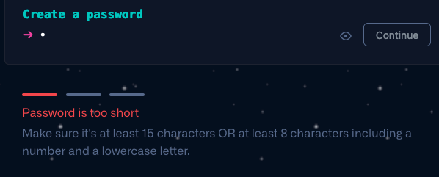
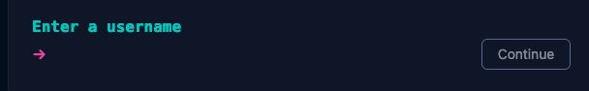
Create a GitHub Account

Slide 23
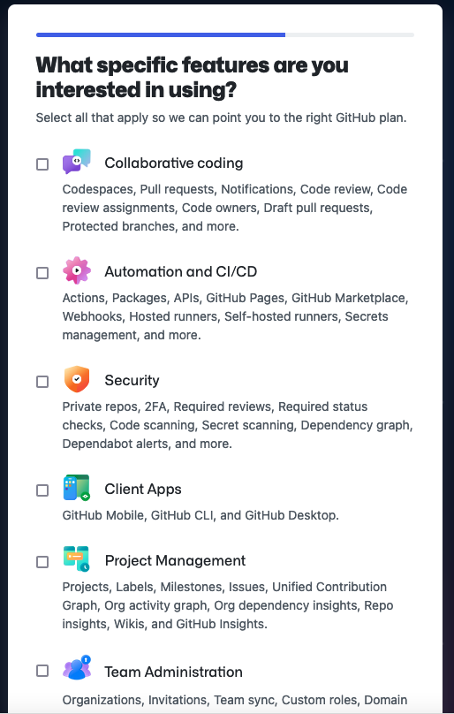
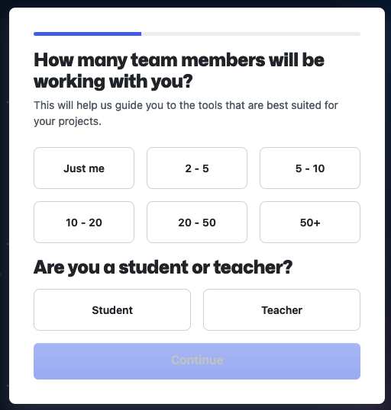

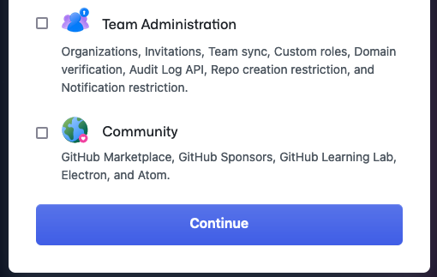

Slide 24
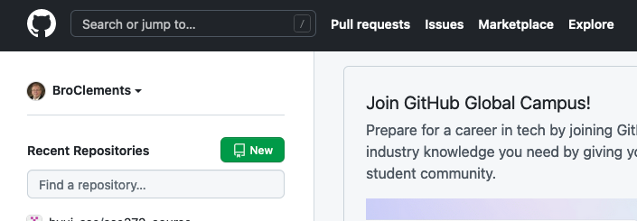
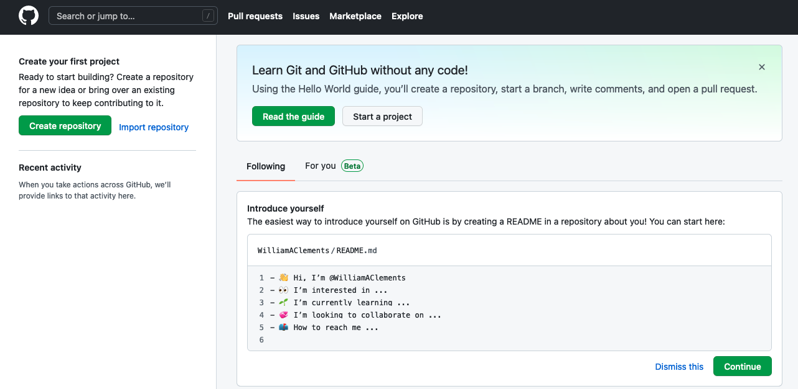
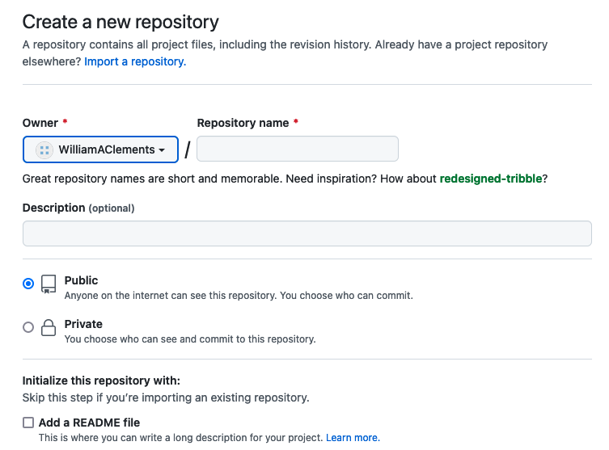
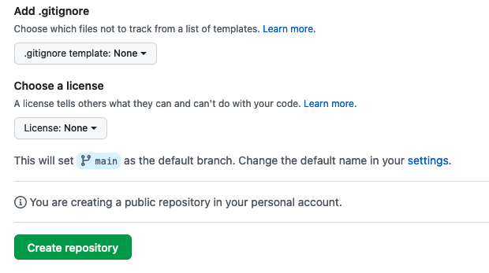
Create Repository
Example : cse170

Slide 25
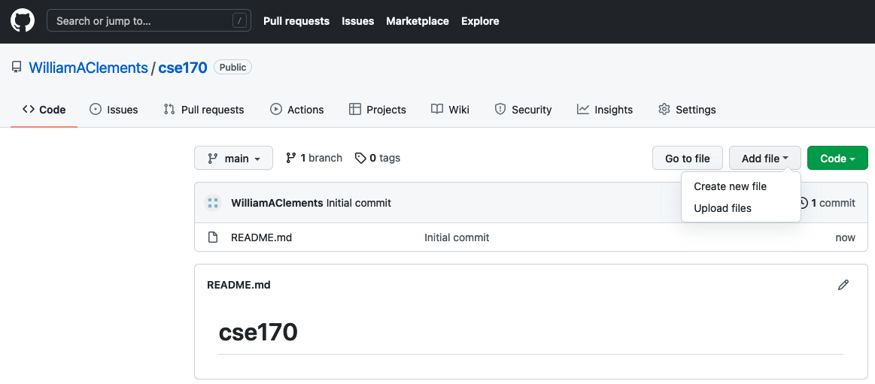
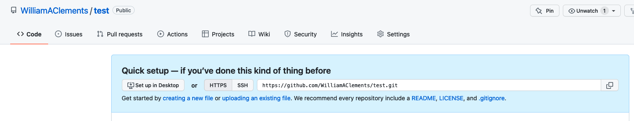
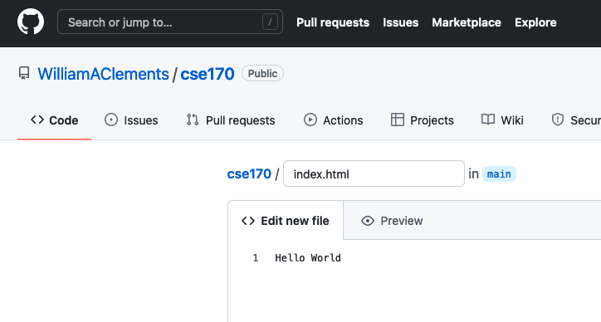
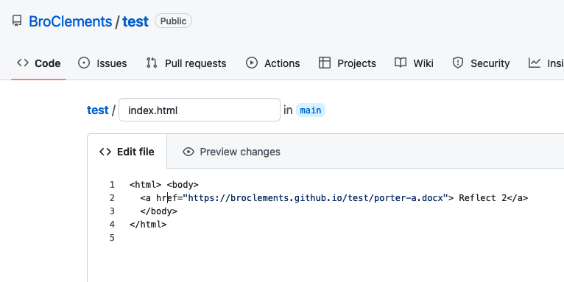
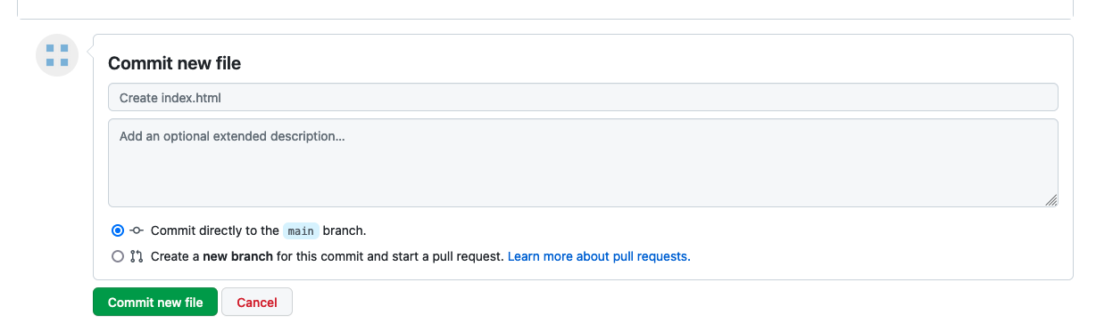
Create an index.html

Slide 26
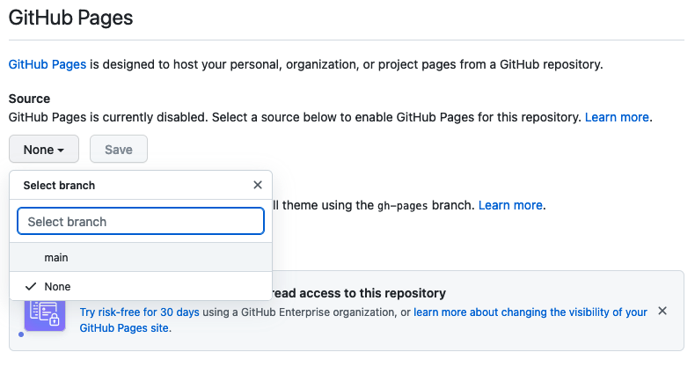
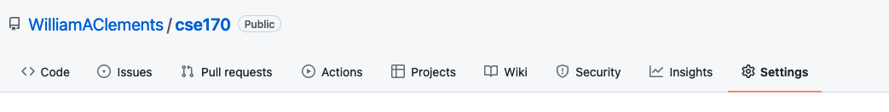
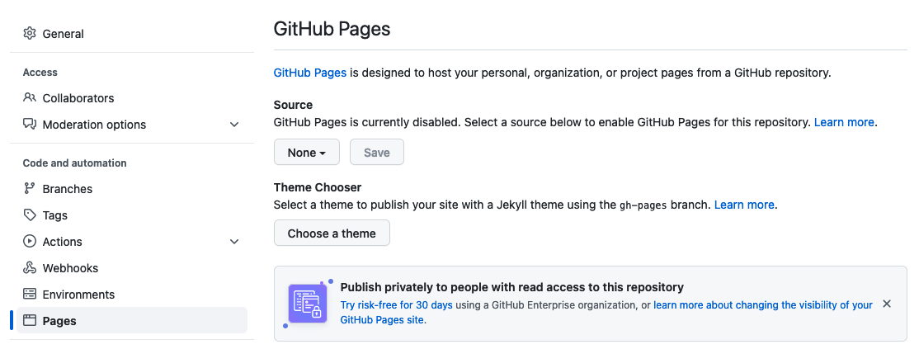
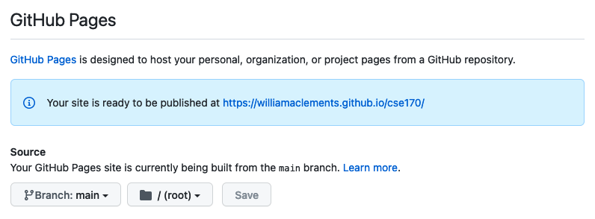
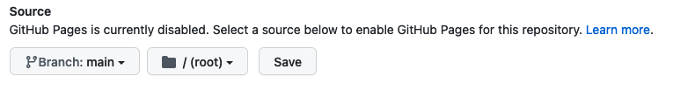
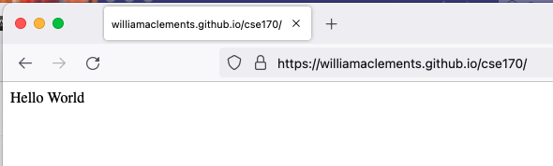
Publish repository

Slide 27
Publish GitHub Pages
Publish the page on GitPages On your GitHub web page, goto Settings
Under General, Click on Pages.
Turn on gitPages.
Test your index.html page, by bringing up the webpage.

Slide 28
New way of submitting homework
PC
LMS: Canvas: iLearn
Folder
Reflection.doc/pdf
Upload
GitHub
Commit
Push
Reference
GitHubDesktop
GitPages
Link

Slide 29
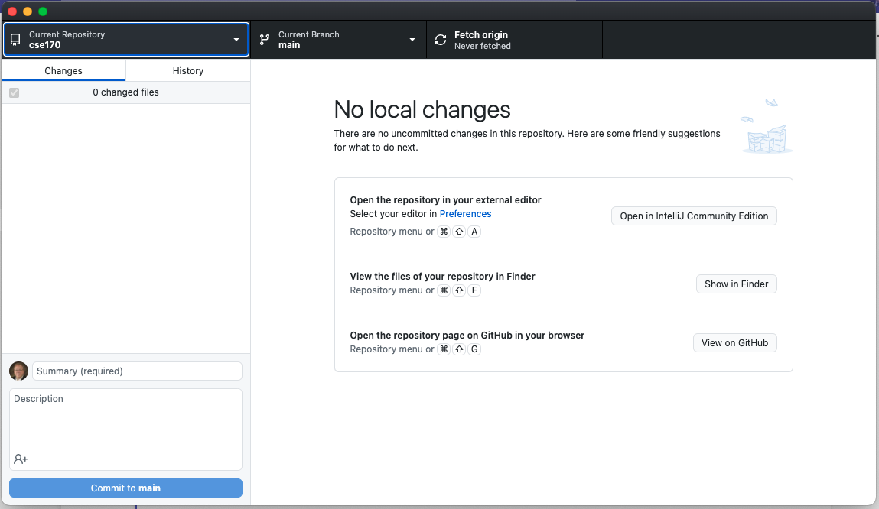
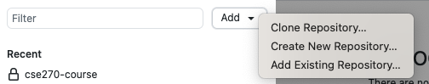
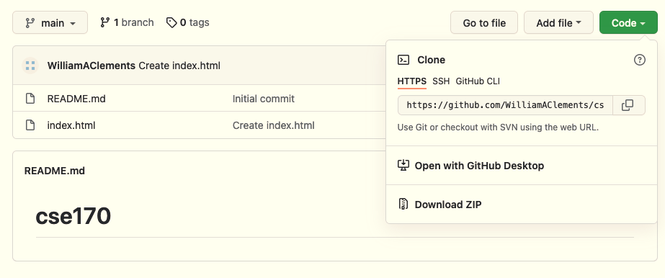
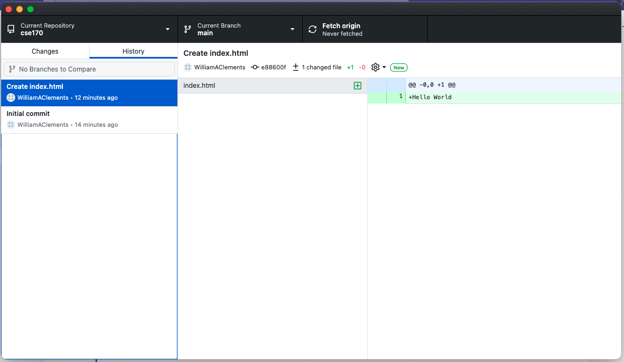
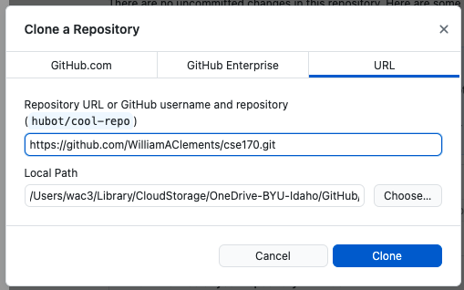
GitHub Desktop Application
Back at GitHub.com
Click on History and you should see your index.html
This needs to be an empty directory

Slide 30
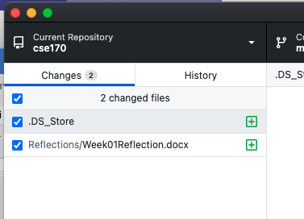
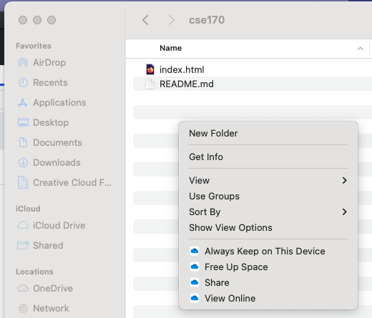
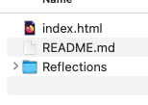
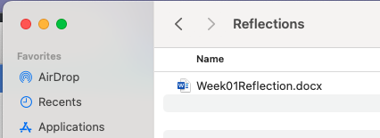
Adding file to local
Folder
Reflection.doc/pdf

Slide 31
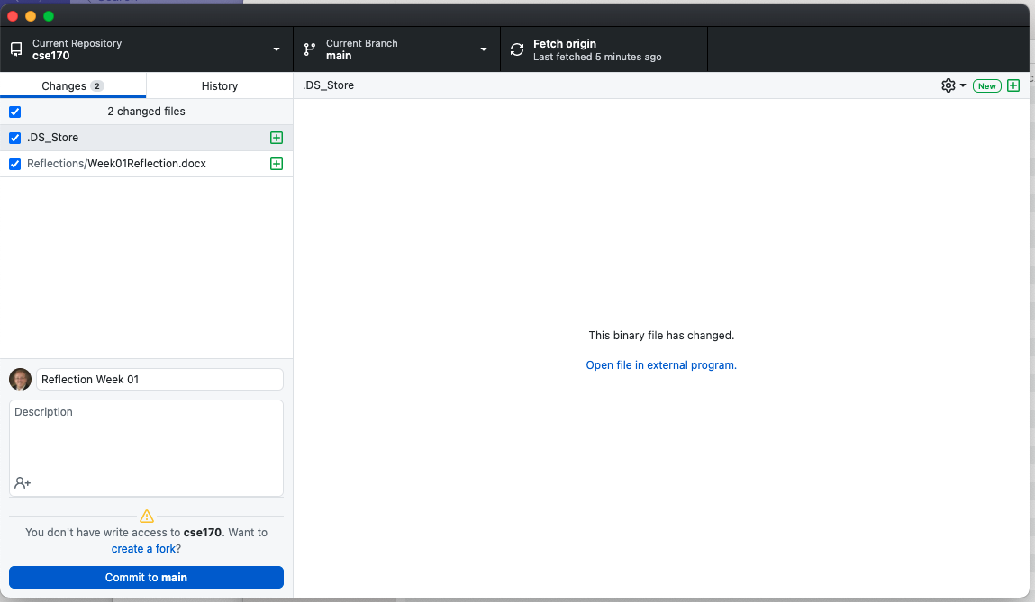
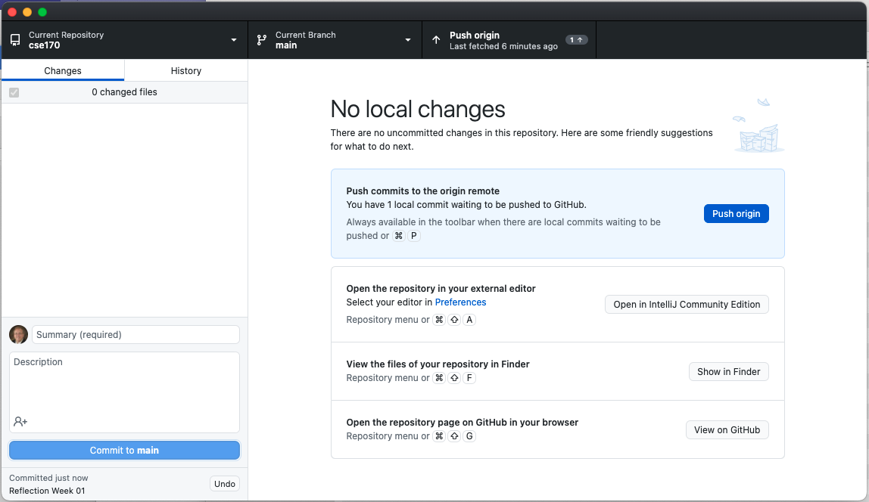

Commit Files
GitHub

